Slide 1


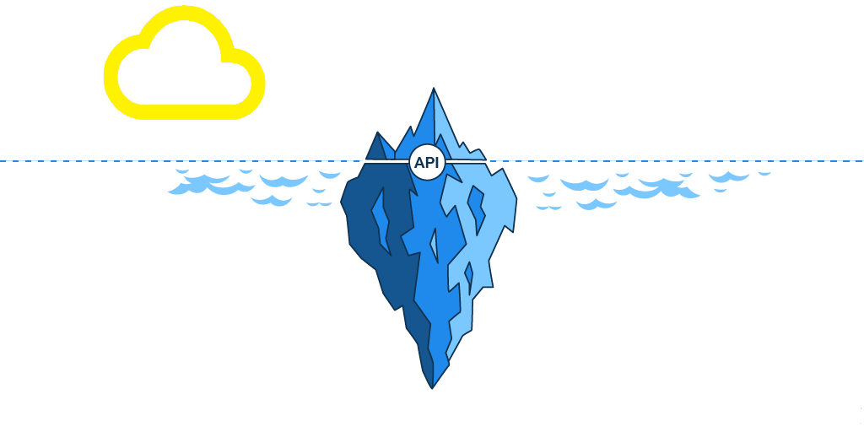









Server
JSON
Request
Front-End
API
Back-End
E
T
L

Slide 2
API Routs
Input Routs:
/api/v1.0/years
/api/v1.0/countries
/api/v1.0/regions /api/v1.0/admission_classes
Data Routs:
api/v1.0/migration_data/(demography)
/api/v1.0/immigrants_by_county/(countries or regions)/(years)/(top)
/api/v1.0/immigrants_by_state/(countries or regions)/(years)/(top)
/api/v1.0/diversity_by_state/(locations)/(years)/(top)
Notes:
1 min

Slide 3
API Routs
api/v1.0/migration_data/(demography)
/api/v1.0/immigrants_by_county/(countries or regions)/(years)/(top)
/api/v1.0/immigrants_by_state/(countries or regions)/(years)/(top)
/api/v1.0/diversity_by_state/(locations)/(years)/(top)
Demography
Notes:
1 min

